Slide 1
TAKENMIND GLOBAL DATA ANALYTICS INTERNSHIP
Proof of concept
Name :- Poojari . Venkatesh
Country :- India
Email-id :- venkatesh.p18@iiits.in
Linkedin Profile :- https://www.linkedin.com/in/venkatesh-poojari-984007181/
Project title :- EMPLOYEE ATTRITION CONTROL

Slide 2
Theory of Constraints
Problem Statement
Solution Methodology
Methodology Visualization
Observations
Recommendations

Slide 3
Problem Statement
Explaining the reasons why employee prone to leave the company after analysing the dataset
Explaining what type of employee are prone to leave the company
Predicting the future who would tend to leave the company

Slide 4
Solution Methodology
In other to proffer solution to the challenges faced by the company using data analytics to derive insights from the data available, the following techniques were adopted
Step -1 :- UNI VARIANT ANALYSIS
In this analysis the information of individual employee that are left will be compared with the information of individual employee that are existing in order to draw the patterns and insights.
Step - 2 :- BI / MULTI VARIANT ANALYSIS
In this analysis two or more types of information of individual employee that are left will be compared with two or more types of information of individual employee that are existing in order to draw the patterns and insights.

Slide 5
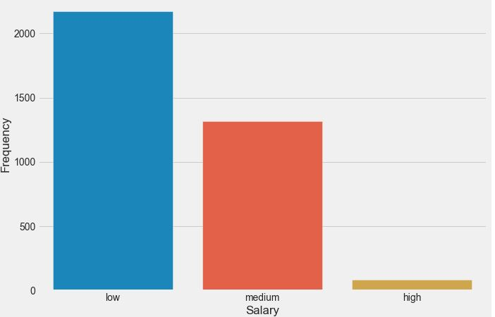
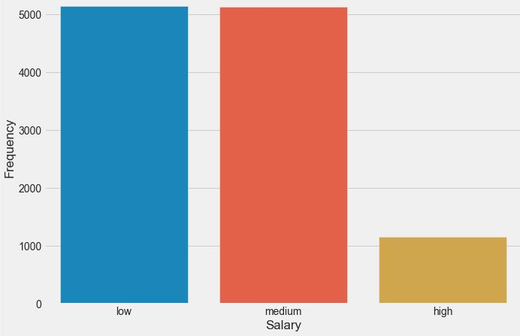
Methodology Visualization
Distribution of salaries of employees left
Distribution of salaries of existing employees
Step - 1 :- UNI VARIANT ANALYSIS
This stage involves individual information of the data
Chart - 1

Slide 6
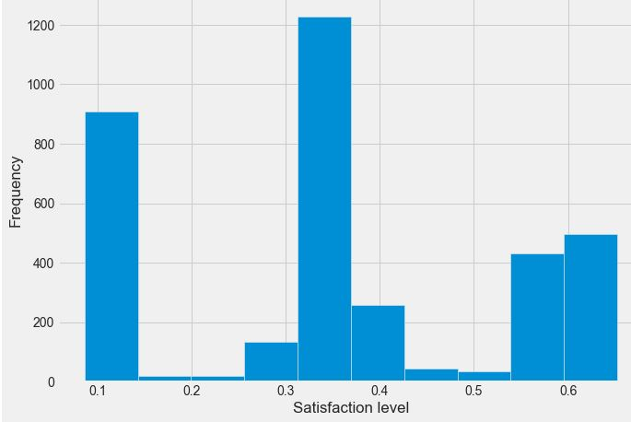
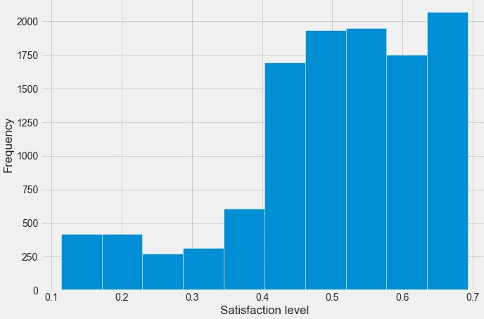
Distribution of satisfaction level of employees left
Distribution of satisfaction level of existing employees
UNI VARIANT ANALYSIS
Chart - 2

Slide 7
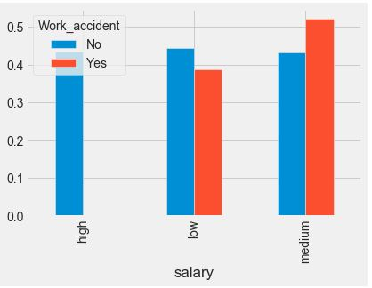
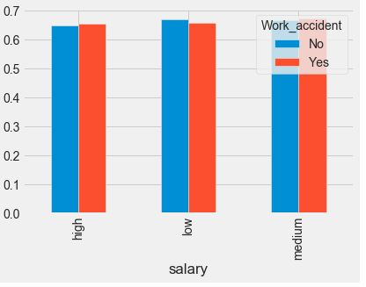
Satisfaction level of employee that left based on work accident salary compensation
Satisfaction level of existing employee based on work accident salary compensation
Step - 2 :- BI VARIANT ANALYSIS
This stage involves different informations of the data and how they are related
Chart - 3

Slide 8
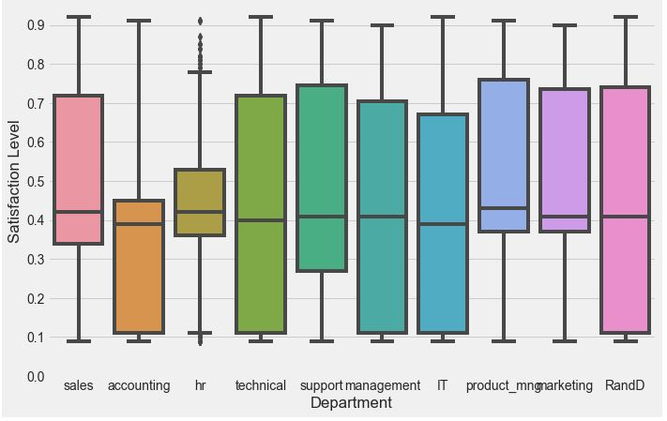
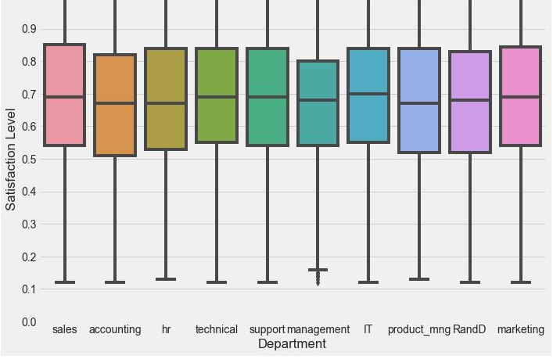
Satisfaction level of employee that left
Satisfaction level of existing employee
BI VARIANT ANALYSIS
Chart - 4

Slide 9
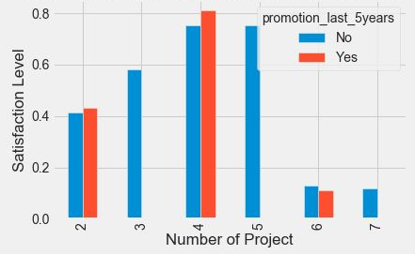
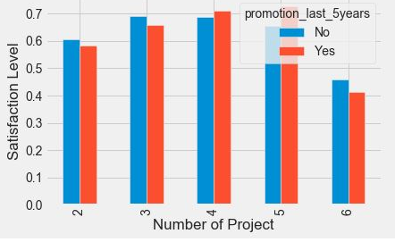
Satisfaction level of employee that left based on number of projects and promotion
Satisfaction level of existing employee based on number of projects and promotion
BI VARIANT ANALYSIS
Chart - 5

Slide 10
Observations
After exploring the data of the Employees that are existing and those that are left simultaneously , the following insights and observations are discovered
From chart 2 the mean satisfaction level of the employees that left are 40% and that of existing are 70%. On further dive employees satisfaction level is 45% who had left. It was further discovered that 99.6% didn’t receive promotion in last 5 years.
From chart 3 the mean satisfaction level was approximately 50% for the employees those left who had work accident as they have a salary structure in low and median range. Comparing with those employees present in the company have salaries low , medium and high range which increased their satisfaction level.
From chart 5 we can notice that as the employees who left the company have more than 4 projects which results in decreasing their satisfaction level.

Slide 11
Recommendation
From the insights of the employees that are left provides us a thought as same satisfaction level of 45% and it was noticed that 13.8% of existing employees are haven’t promoted within the last 5 years making them prone to leave. To control the attrition, these employees need to be identified and their satisfaction level to be increased
For the employees who met with work accidents company maintained a good salary structure which improved their satisfaction level. So to control the attrition, the company need to maintain a good salary structure or improve it to maintain good satisfaction level of the employees
And also the company should not give more projects to the employees which decreases their enthusiasm which results to decrease in their satisfaction level which making them prone to leave the company

Slide 12
Thank you TAKENMIND for this internship to improve my Data Analytic skills

